Slide 1
Capstone Project-1 Customer Segmentation by Group-2
31 Oct 2022
F1218-Burhanettin
F1670-Osman
F1322-Joseph
F1386-Harun
F1239-Ilker
“Success is not final, failure is not fatal; it is the courage to continue that counts.” – Winston Churchill

Slide 2
Our Findings
Data is imbalanced (UK skewed) and noisy.
RFM analysis is consistent with K-Means clustering.
K-means is indicating 5 clusters.
Cohort analysis shows a seasonal underlying structure.

Slide 3
Data Cleaning & Exploratory Data Analysis
df.shape; 541909 rows and 8 columns
df.duplicated().value_counts(); 5268 duplicate values
df=df.drop_duplicates();The repetitive rows dropped, 'df.shape' shows 536641 values
df.info(); customer_id column has missing values
df.isnull().sum(); The CustomerID and Description fields have null values.
-Description:1454 rows
-CustomerID:135037 rows

Slide 4
Data Cleaning & Exploratory Data Analysis
df.describe(); Quantity and UnitPrice should have a value >= 0, but from the summary above there are negative values for the two columns.
If it is checked the relationships between 'InvoiceNo', 'Quantity' and 'UnitPrice' columns, negative values are seen in the Quantity and UnitPrice columns.
These are possibly canceled and returned orders.
These rows can not be used for the analysis, so we dropped them(36% of the orders)

Slide 5
Data Cleaning & Exploratory Data Analysis
Handling Missing Values
CustomerID has missing values, this means related orders were not made,
Clean the Noise and Missing Values
Missing values should be excluded from the dataset.
-dropped customerID with null value
-dropped Quantity and UnitPrice with negative value - Results-3
Following the cleaning, 'df.shape': (392692, 8)

Slide 6
RFM Analysis & Customer Segmentation
Retention, loyalty, and building customer relationships are the key factors for success of any business sector today.
Instead of analyzing the entire customer base as a whole, it’s better to segment them into homogeneous groups, understand the traits of each group, and engage them with relevant campaigns rather than segmenting on just customer age or geography.
One of the most popular, easy-to-use, and effective segmentation methods to enable marketers to analyze customer behavior is RFM analysis.

Slide 7
RFM Analysis & Customer Segmentation
RFM stands for Recency, Frequency, and Monetary concepts. It is a customer segmentation technique for analyzing customer value based on past buying behavior. RFM analysis was first used by the direct mail industry more than four decades ago, yet it is still an effective way to optimize your marketing.

Slide 8
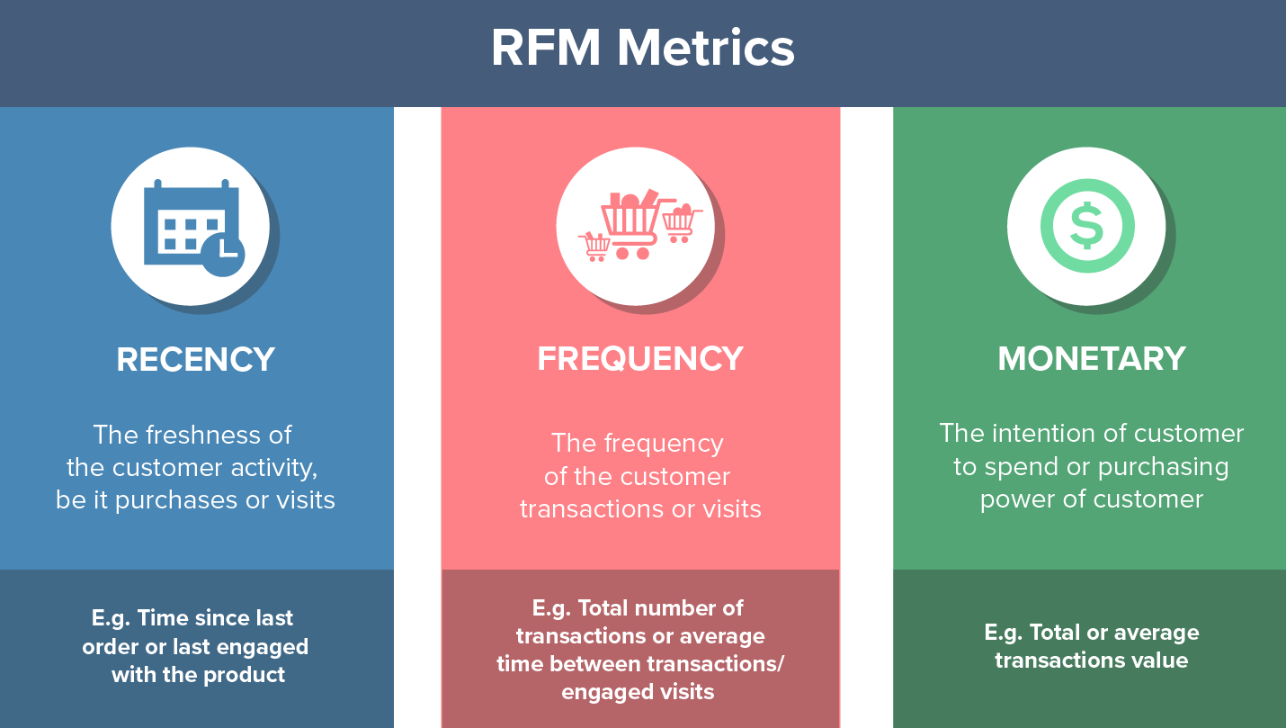
RFM Analysis & Customer Segmentation

Slide 9
RFM Analysis & Customer Segmentation
Benefits of RFM Analysis:
- Increased customer retention
- Increased response rate
- Increased conversion rate
- Increased revenue

Slide 10
RFM Analysis & Customer Segmentation
RFM Analysis answers the following questions:
Who are your best customers?
Which customers have a chance to churn?
Who has the potential to become valuable customers?
Who are your loyal customers?
Who are your new customers?
Which customers is critical to retain?
Which group of customers is most likely to respond to your current campaign?
Which customers are lost? and more

Slide 11
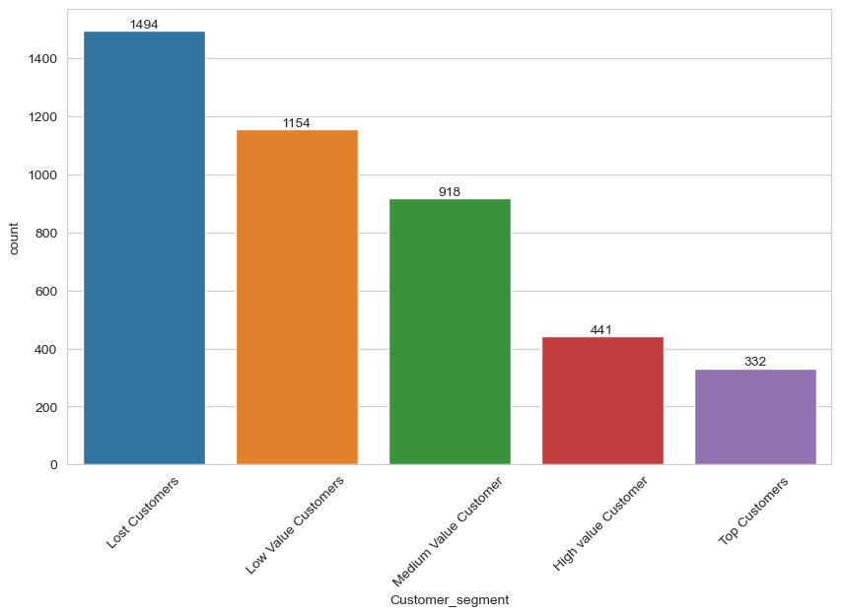
RFM Analysis & Customer Segmentation
Weighted RFM customer segments

Slide 12
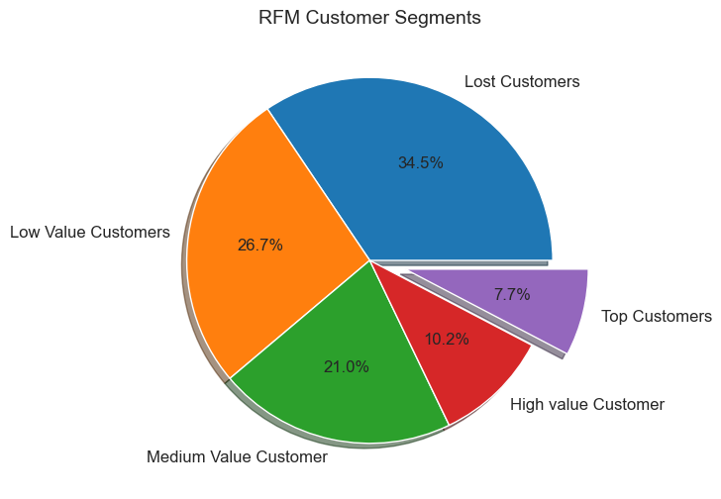
RFM Analysis & Customer Segmentation
Weighted RFM customer segments

Slide 13
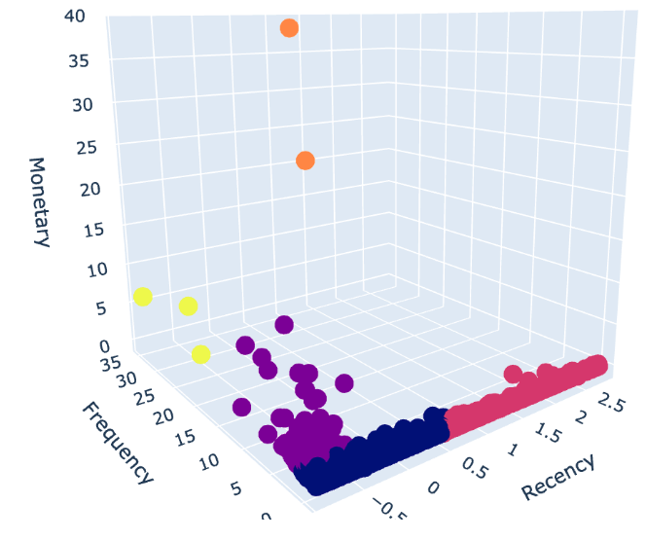
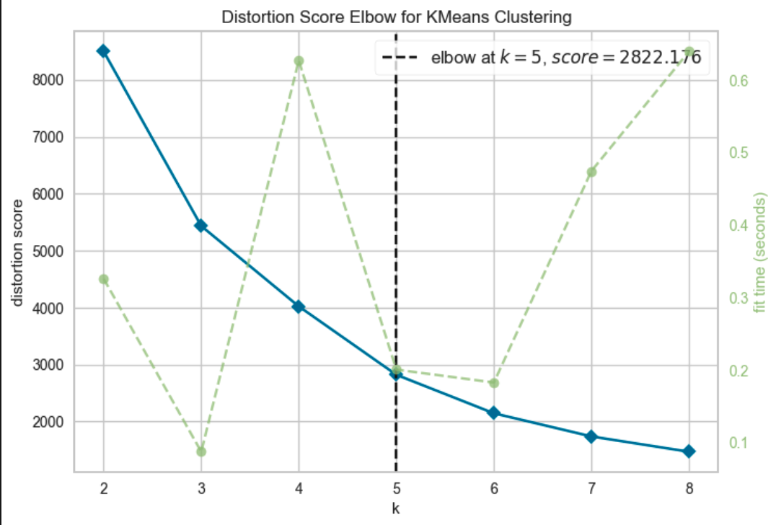
K-Means
Clustering
UK Data
(MinMax Scaler)

Slide 14
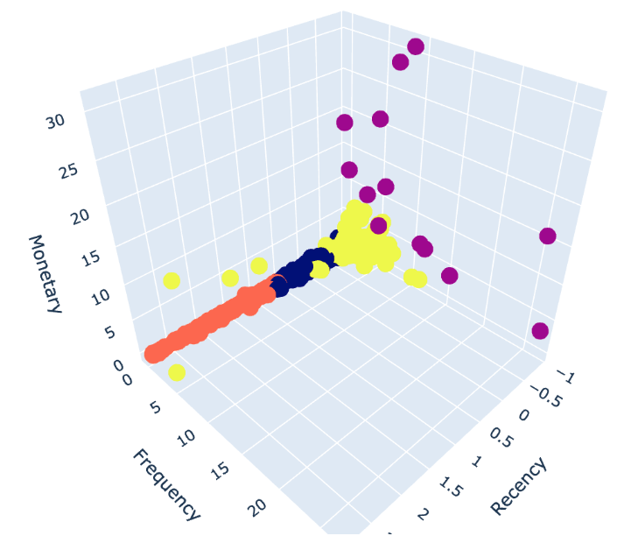
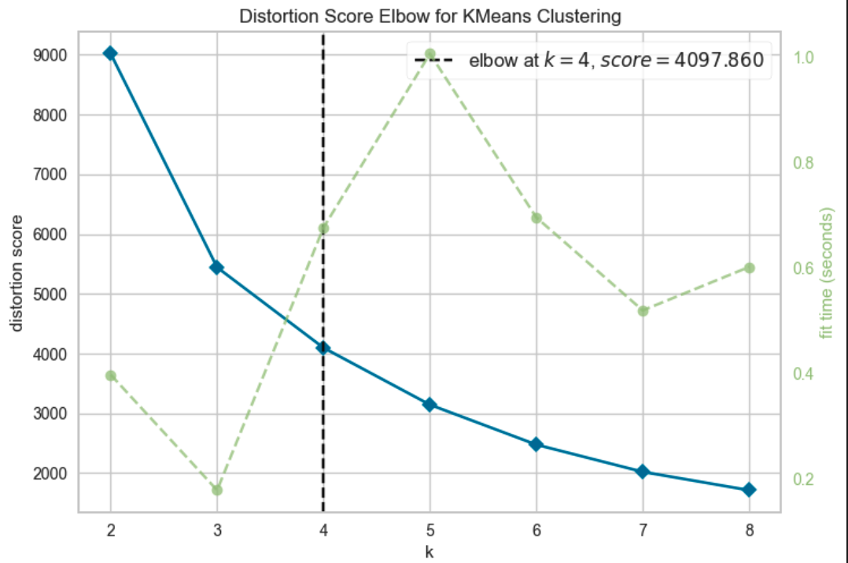
K-Means
Clustering
Global Data
(Standard Scaler)

Slide 15
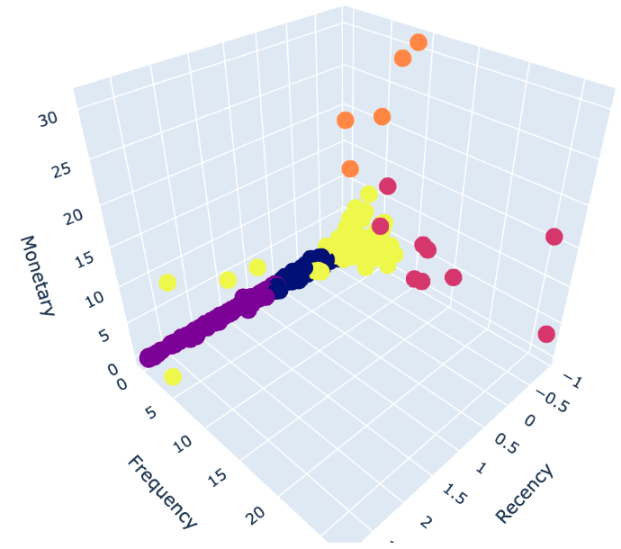
K-Means
Clustering
Global Data
(Standard Scaler)

Slide 16
Cohort Analysis
A cohort is a group of people who share a common characteristic over a certain period of time, such as users that have become customers at approximately the same time, a graduating class of students.
Cohort analysis is an analytical technique that categorizes and divides data into groups with common characteristics prior to analysis.
This technique is typically used
to make it easier for organizations to isolate, analyze, and detect patterns in the lifecycle of a user,
to improve user retention,
and to better understand user behavior in a particular cohort.

Slide 17
Steps Of Cohort Analysis
Creating cohort groups:
Group user data into different buckets, such as date joined, date of first purchase, graduation year, at a particular place and time, etc.
Cohort indexes:
subsequent time periods are calculated as cohort indexes as monthly or weekly etc. (according to the data and domain)
The behavior of the customers in these time periods (cohort indexes) are analyzed.
Pivot tables and heatmaps are mostly used for presenting the data.

Slide 18
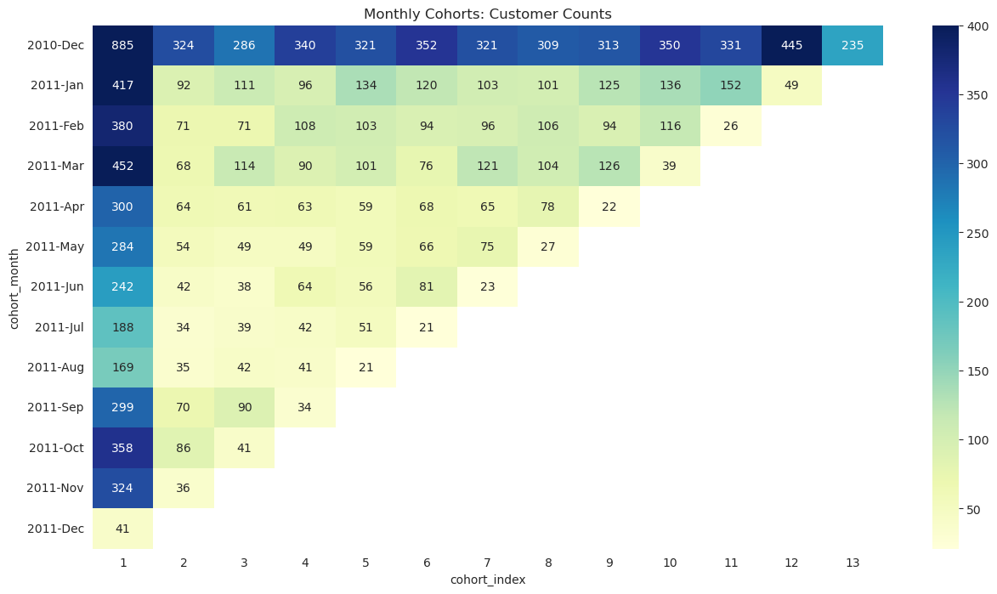

Slide 19
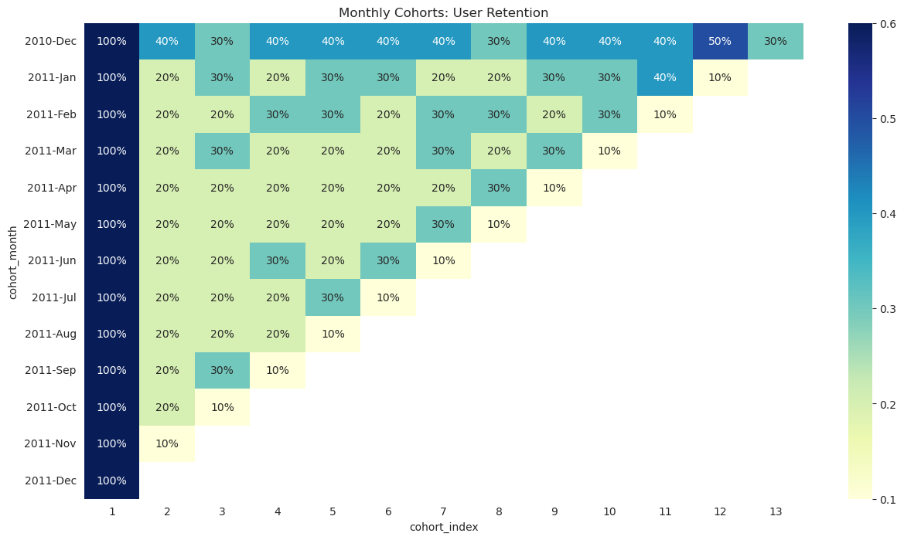

Slide 20
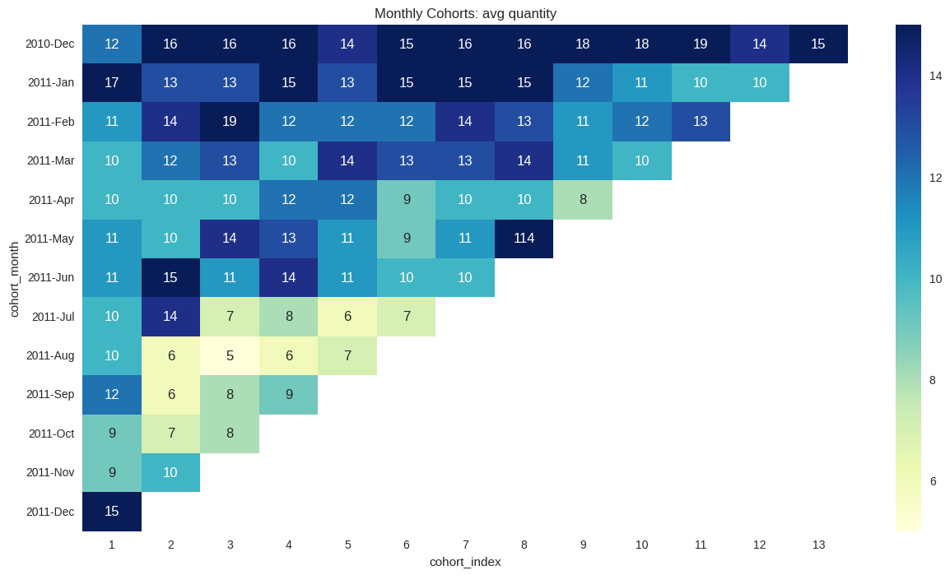

Slide 21
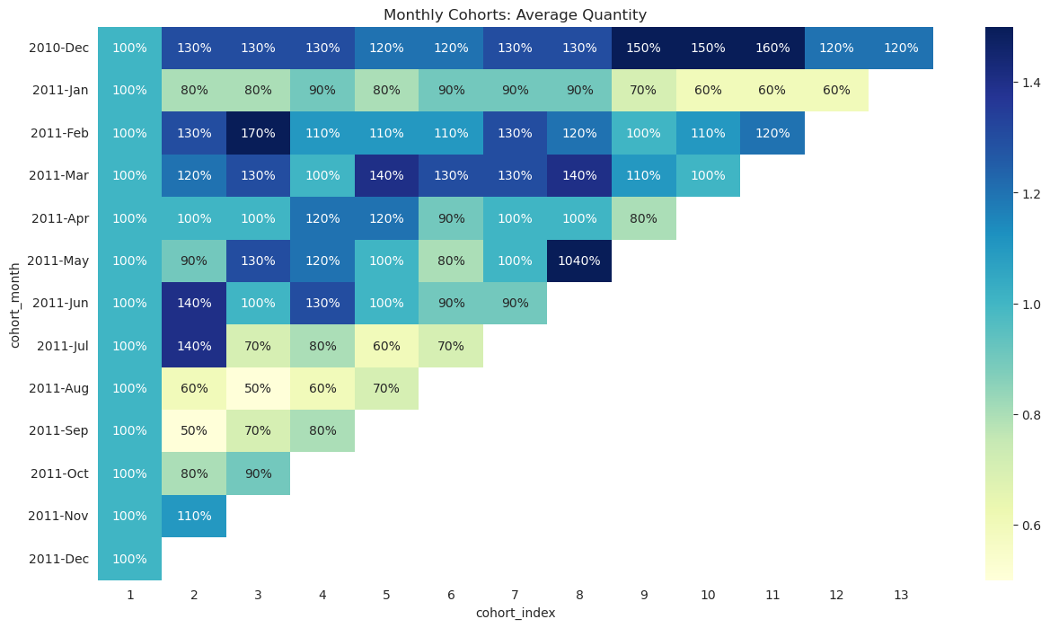
Conclusion

Slide 22
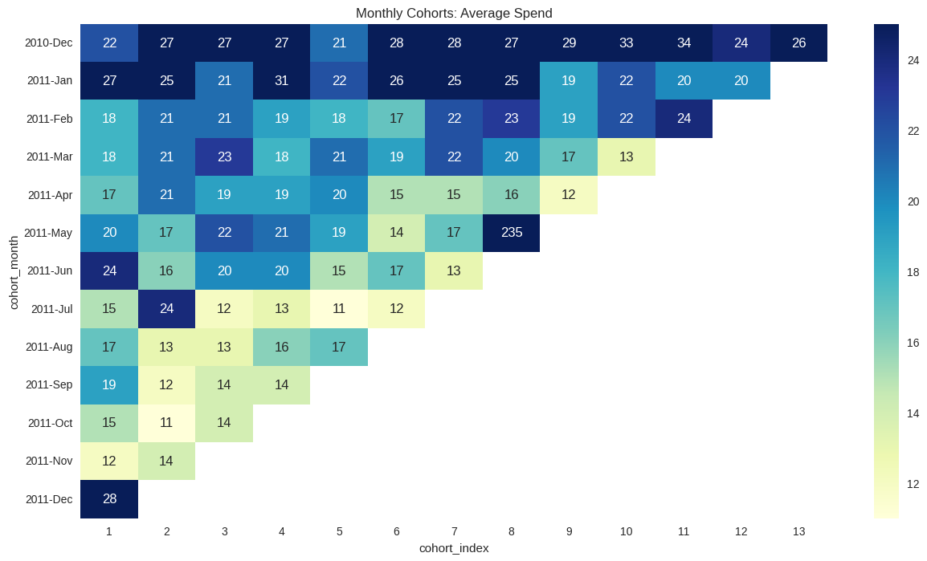

Slide 23
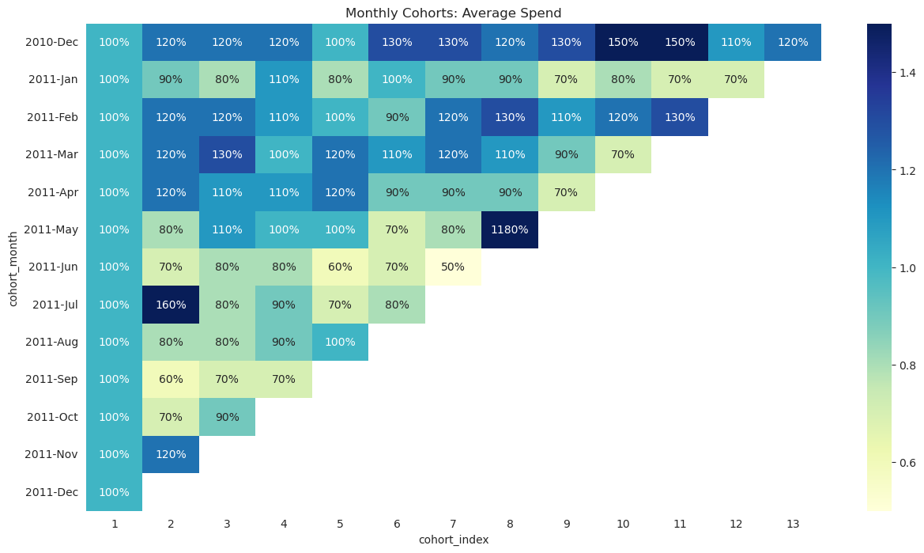

Slide 24
Thanks

Slide 25
RFM Analysis & Customer Segmentation (6)
Calculation of RFM:
STEP 1: MEASURING EACH VARIABLE
- RECENCY (R):
Time measured in days since each customer made their last purchase
- FREQUENCY (F):
Total number of purchases
- MONETARY VALUE (M):
Total amount of money each customer spends

Slide 26
RFM Analysis & Customer Segmentation (7)
Calculation of RFM:
STEP 2: STANDARDIZING EACH ITEM
With the help of Quantile-based discretization function, ``pd.qcut()``, we discretize variables into 5 equal-sized buckets based on rank or based on sample quantiles.
- RECENCY (R): Most recent top 20% → 5, least recent bottom 20% → 1
- FREQUENCY (F): Most frequent top 20% → 5, least frequent bottom 20% → 1
- MONETARY VALUE (M): Highest spending 20% → 5, least spending bottom 20% → 1
RFM Score = (Recency + Frequency + Monetary) / 3 → (RANGES FROM 5 TO 1)

Slide 27
RFM Analysis & Customer Segmentation (8)
USING WEIGHTS IN CALCULATION OF RFM:
Weighting in RFM will be different for each business sector. Therefore, each sector might assign a different weight to Recency, Frequency, and Monetary components.
Adjusted RFM Formula with Weights:
RFM Score = (Recency*WeightR + Frequency*WeightF + Monetary*WeightM) / 3
where WeightR + WeightF + WeightM = 1

